Slide 1

University of North Texas
CSCE 2110
Foundations of Data Structures
Tree

Slide 2
Contents
Tree
Tree Traversal
Binary Trees
Binary Search Tree (BST)
Balanced BST
AVL Tree
Splay Tree

Slide 3

Nature View of a Tree
leaves
branches
root

Slide 4
Computer Scientist’s View
root
leaves
branches
node

Slide 5
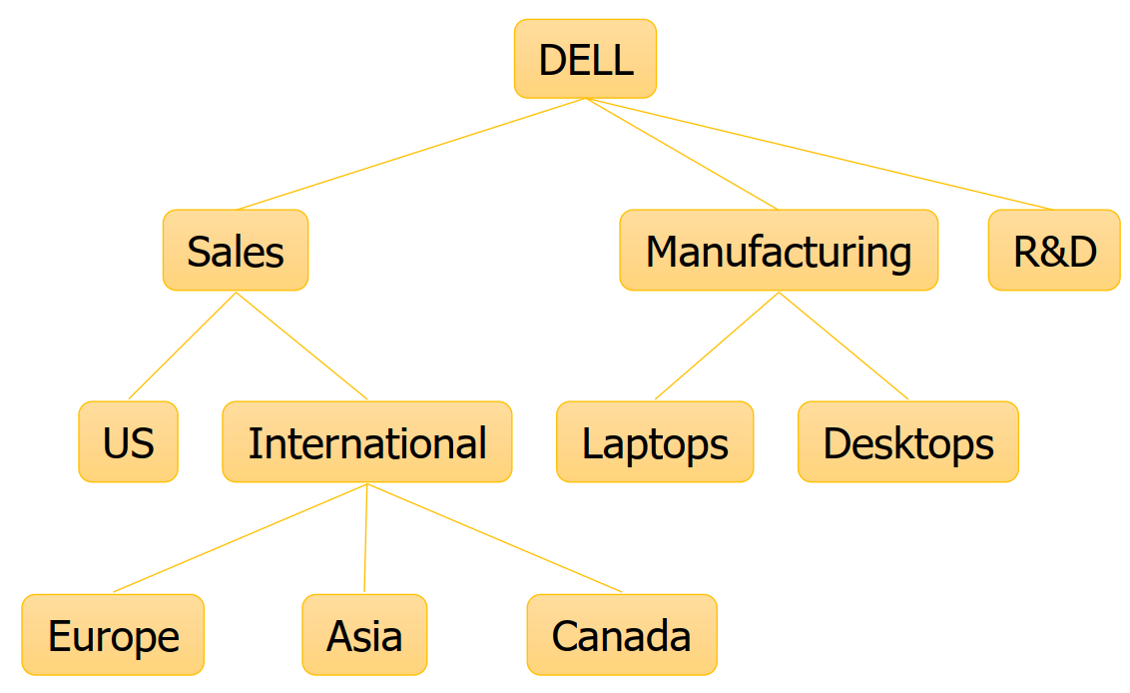
What is a Tree
A tree is a finite nonempty set of elements.
It is an abstract model of a hierarchical structure.
consists of nodes with a parent-child relation.
Applications:
Organization charts
File systems

Slide 6
Definition and Tree Trivia
Recursive Definition of a Tree:
A tree is a set of nodes that is
(a) an empty set of nodes, or
(b) has one node called the root from which zero or more trees (subtrees) descend.
A tree with 𝑁 nodes always has edges

Slide 7
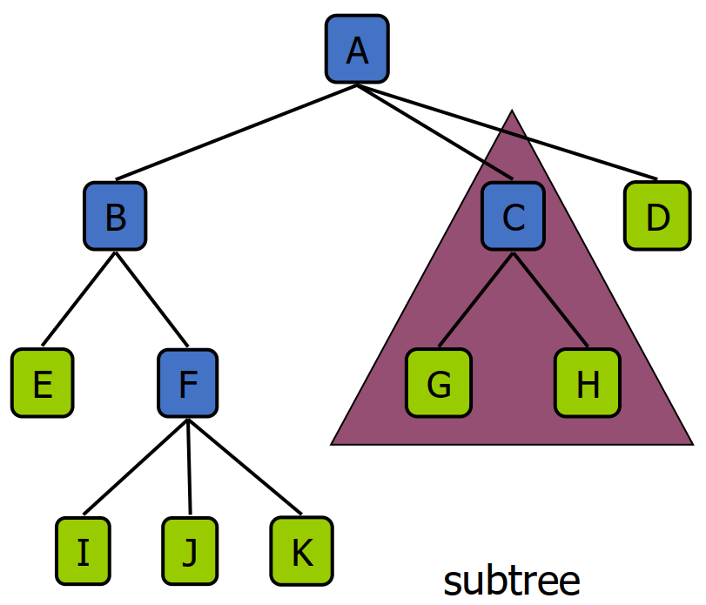
Tree Terminology
Root: node without parent (A)
Siblings: nodes share the same parent
Internal node: node with at least one child (A, B, C, F)
External node (leaf): node without children (E, I, J, K, G, H, D)
Ancestors of a node: parent, grandparent, grand- grandparent, etc.
Descendant of a node: child, grandchild, grand- grandchild, etc.
Depth of a node: number of ancestors
Height of a node: number of edges on the longest path from the node to a leaf
Height/Depth of a tree: maximum depth of any node
Degree of a node: the number of its children
Degree of a tree: the maximum degree of its node.
Subtree: tree consisting of a node and its descendants

Slide 8
YMTT (Yet More Tree Terminology)
Binary tree: each node has at most two children
𝑛-ary trere: each child has at most n children
Complete tree: Each row of the tree is filled in left to right before the next one is started
How deep can a complete binary tree (with n nodes) be?

Slide 9
Tree ADT
We use positions to abstract nodes
Query methods:
integer size()
boolean isEmpty()
objectIterator elements()
positionIterator positions()
position root()
position parent(p)
positionIterator children(p)
Update methods:
insert(p)
delete(p)
swapElements(p, q)
object replaceElement(p, o)
Additional update methods may be defined by data structures implementing the Tree ADT

Slide 10
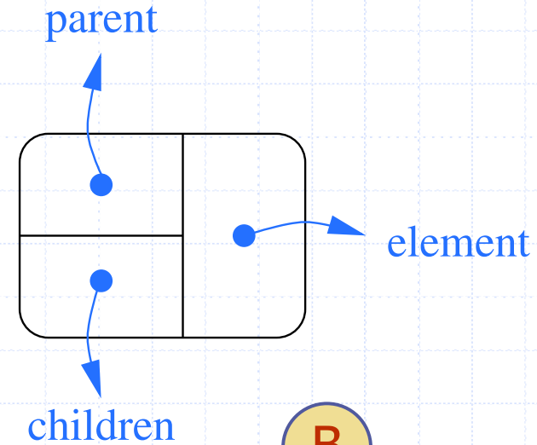

A Tree Representation
A node is represented by an object storing
Element
Parent node
Sequence of children nodes
// A node of N-ary tree
struct node {
char element;
node * parent;
node * child[N];
};

Slide 11
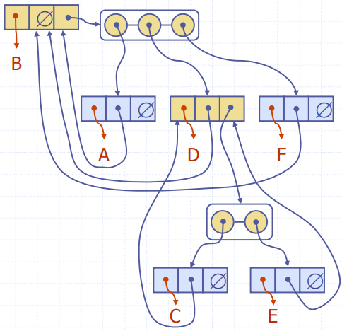
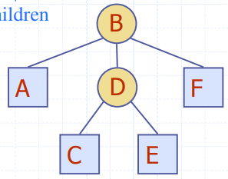
A Tree Representation

Slide 12
Tree Traversals
Walking through a tree is called a traversal
Common kinds of traversal
Pre-order: node, then children
Post-order: children, then node
In-order: left, then node, then right (specific to binary trees)
Level-order: nodes at depth d, nodes at depth d+1, …

Slide 13
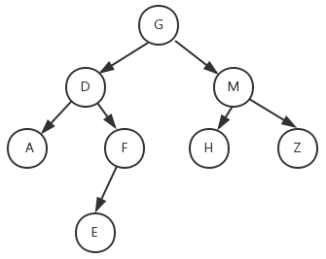
Tree Traversals

Slide 14
Tree Traversals
Pre-order:
G D A F E M H Z
Post-order:
A E F D H Z M G
In-order:
A D E F G H M Z

Slide 15
Tree Traversals
Pre-order:
A B D E G C F
In-order:
D B G E A C F
Post-order:
?

Slide 16
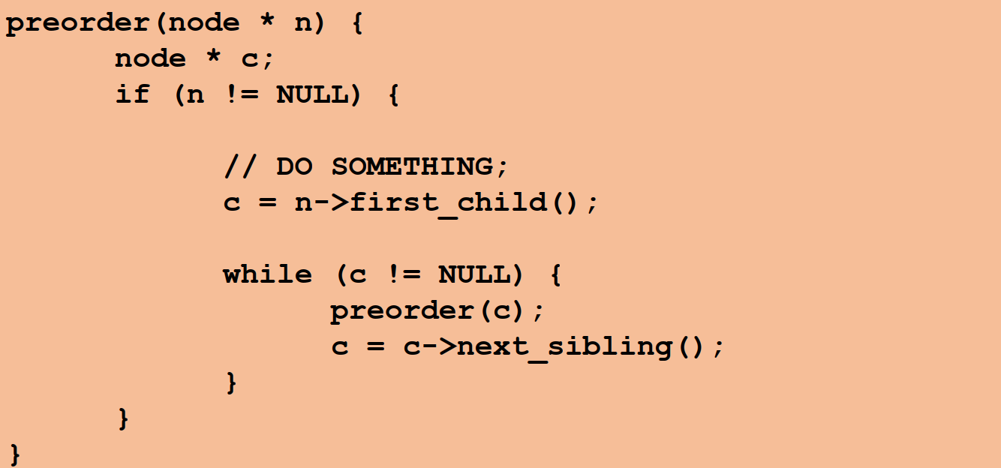
Pre-Order Traversal
Perform computation at the node, then recursively perform computation on each child

Slide 17
Pre-Order Applications
Use when computation at node depends upon values calculated higher in the tree (closer to root)
Example: computing depth
The depth of a node is the number of edges from the node to the tree's root node
depth(node) = 1 + depth( parent of node )

Slide 18
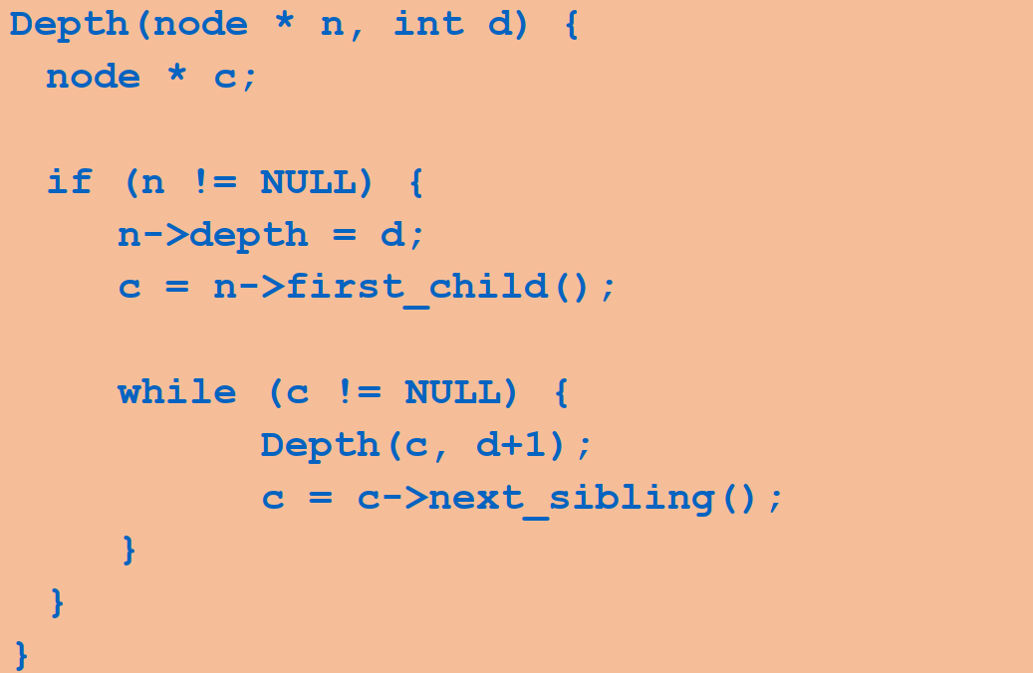
Pre-Order Example: Computing Depth of All Nodes
Add a field depth to all nodes
Call Depth(root,0) to set depth field

Slide 19
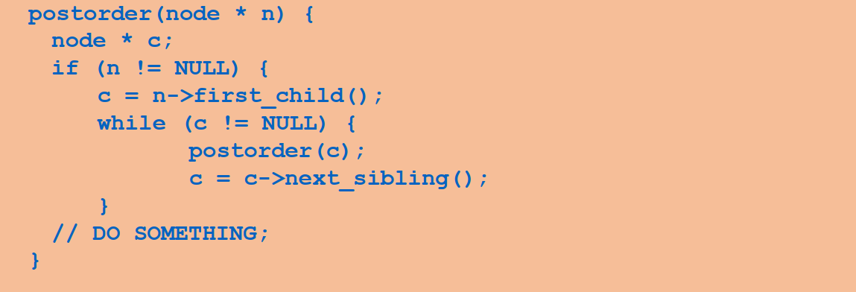
Post-Order Traversal
Recursively perform computation on each child, then perform computation at node

Slide 20
Post-Order Applications
Use when computation at node depends on values calculated lower in tree (closer to leaves)
Example: computing height
The height of a node is the number of edges on the longest path from the node to a leaf.
A leaf node will have a height of 0.
height(node) = 1 + MAX( height(child₁), … height(child_{k}) )
Example: size of tree rooted at node
size(node) = 1 + size(child₁) + … + size(child_{k})

Slide 21
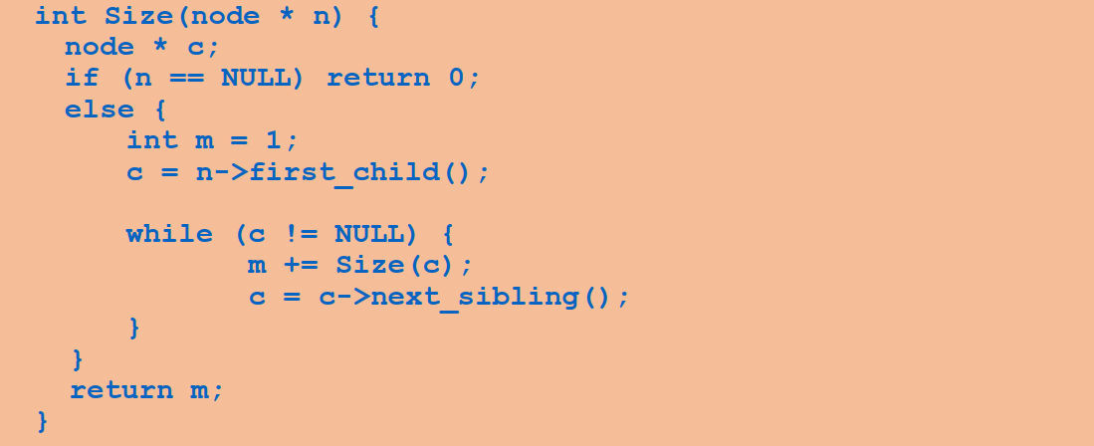
Post-Order Example: Computing Size of Tree
Call Size(root) to compute number of nodes in tree

Slide 22
Depth-First Search
Pre-Order and Post-Order traversals are examples of depth-first search:
Nodes are visited deeply on left-most branches before any nodes are visited on right-most branches
NOTE: visiting right deeply before left would still be depth-first - crucial idea is “go deep first”
In DFS the nodes “being worked on” are kept on a stack (where?)

Slide 23
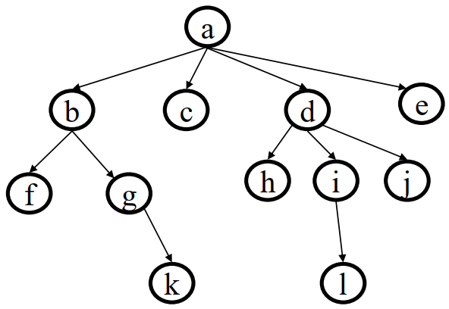
Level-Order (Breadth-First) Traversal
Consider task of traversing tree level-by-level from top to bottom (alphabetic order, in example below)

Slide 24
Level-Order (Breadth-First) Traversal
Consider task of traversing tree level-by-level from top to bottom (alphabetic order, in example below)
Which data structure can best keep track of nodes?

Slide 25
Level-Order (Breadth-First) Algorithm
Put root in a Queue
Repeat until Queue is empty:
Dequeue a node
Process it
Add its children to queue

Slide 26
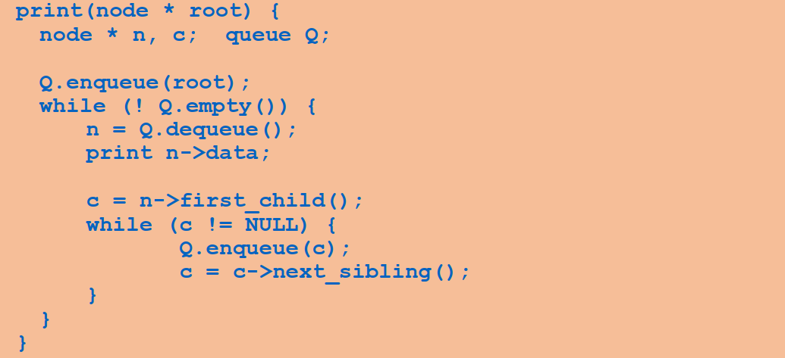
Level-Order Example: Printing the Tree
Call Print(root) to print tree contents

Slide 27
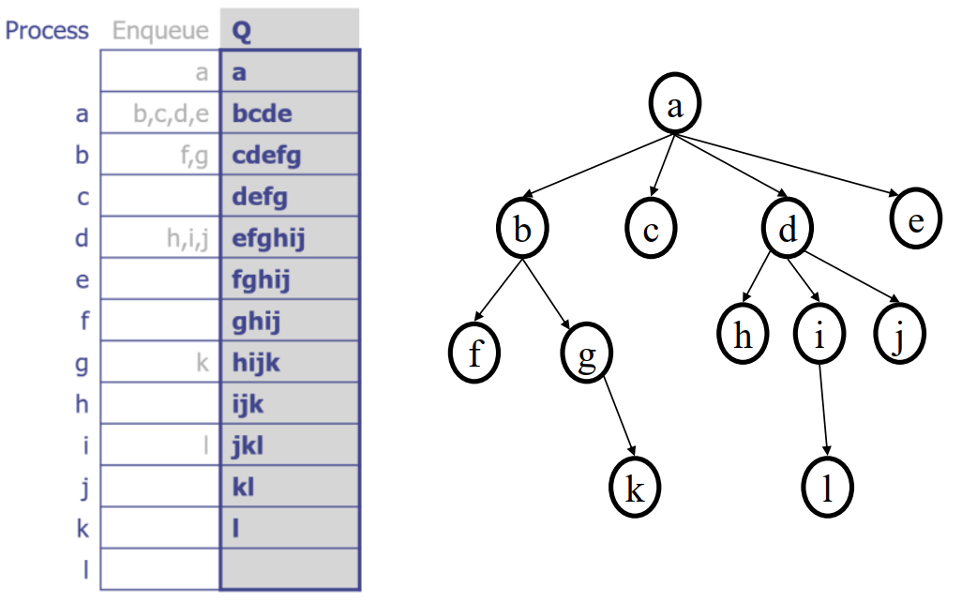
Example: Level-Order Queue
Put root in a Queue
Repeat until Queue is empty:
Dequeue a node
Process it
Add its children to queue

Slide 28
Example: Level-Order Queue

Slide 29
Applications of Breadth-First Search
Find shortest path from root to a given node N
if node N is at depth k, BFS will never visit a node at depth > k
important for really deep trees
Generalizes to finding shortest paths in graphs
Spidering the world wide web
From a root URL, fetch pages that are farther and farther away

Slide 30
Binary Search Tree
Binary Search Trees (BST) are a type of Binary Trees with a special organization of data.
Every element has a unique key.
The keys in the nonempty left subtree (right subtree) are smaller (larger) than the key in the root of subtree (BST property)
The left and right subtrees are also binary search trees.

Slide 31
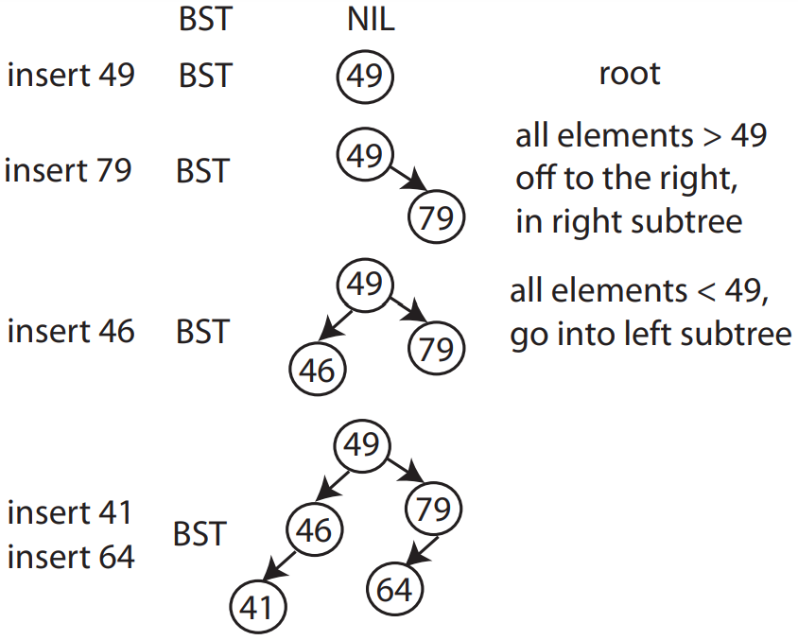
Binary Search Trees (BST)
Insertion: insert(val)
typedef struct BinaryNode {
int key;
BinaryNode *right; BinaryNode *left;
}ptnode;

Slide 32
Insertion into a BST
void insert (ptnode * & node, int key){
if (!node){
node = (ptnode) malloc(sizeof(ptnode));
node->key = key;
node->left = node->right = NULL;
} else if (key < node->key)
{
insert(node->left, key);
} else if (key > node->key)
{
insert(node->right, key);
}
}

Slide 33
Finding a value in the BST if it exists: find(val)
Follow left and right pointers until you find it or hit NULL.
Search in BST – Pseudocode
if the tree is empty
return NULL
else if the item in the node equals the target
return the node value
else if the item in the node is greater than the target
return the result of searching the left subtree
else if the item in the node is smaller than the target
return the result of searching the right subtree

Slide 34
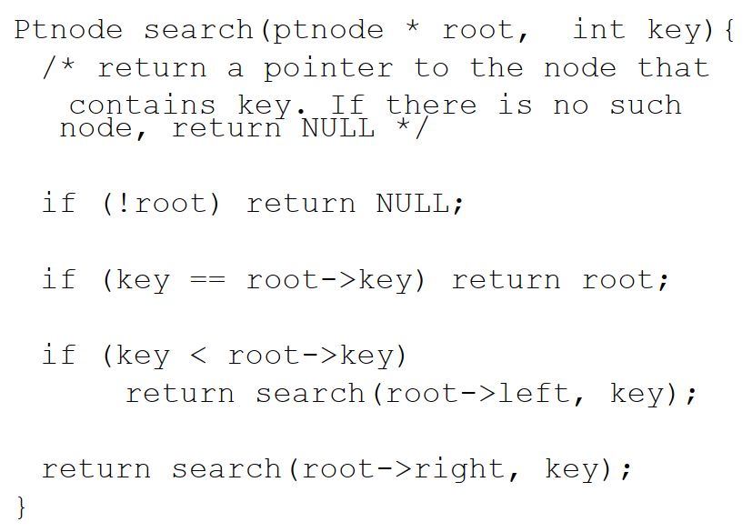
Search in a BST

Slide 35
Finding the minimum element in a BST: findmin()
How?

Slide 36
Finding the minimum element in a BST: findmin()
Key is to just go left till you cannot go left anymore.

Slide 37
BST Operations: Removal
uses a binary search to locate the target item:
starting at the root it probes down the tree till it finds the target or reaches NULL
removal of a node must not leave a ‘gap’ in the tree,

Slide 38
Removal in BST - Pseudocode
if the tree is empty return false
Attempt to locate the node containing the target using the binary search
if the target is not found return false
else the target is found, so remove its node:
Case 1: if the node has 2 empty subtrees
― replace the link in the parent with null
Case 2: if the node has a left and a right subtree
― replace the node's value with the max value in the left subtree
― delete the max node in the left subtree

Slide 39
Removal in BST - Pseudocode
if the tree is empty return false
Attempt to locate the node containing the target using the binary search
if the target is not found return false
else the target is found, so remove its node:
Case 3: if the node has no left child
― link the parent of the node to the right (non- empty) subtree
Case 4: if the node has no right child
― link the parent of the target to the left (non- empty) subtree

Slide 40
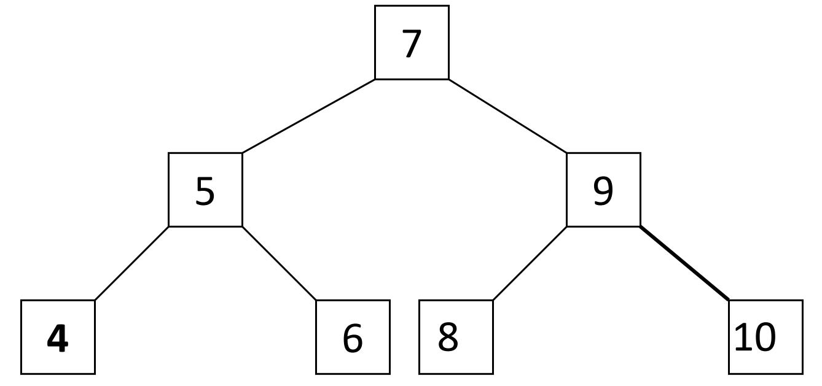
Removal in BST: Example
Use the algorithm to delete an item.
Delete 9?
Delete 7?
Delete 10?

Slide 41
Removal in BST: Example
Case 1: removing a node with 2 EMPTY SUBTREES
parent
7
cursor
5
9
4
6
8
10
Removing 4

Slide 42
Removal in BST: Example
Case 1: removing a node with 2 EMPTY SUBTREES
parent
7
cursor
5
9
4
6
8
10
7
Removing 4
replace the link in the parent with null
after removal
5
9
6
8
10

Slide 43
Removal in BST: Example
Case 2: removing a node with 2 SUBTREES
Removing 7
cursor
7
5
9
4
6
8
10

Slide 44
Removal in BST: Example
Case 2: removing a node with 2 SUBTREES
replace the node's value with the max value in the left subtree
delete the max node in the left subtree
Removing 7
cursor
cursor
7
6
5
9
5
9
4
6
8
10
4
8
10
after removal

Slide 45
Removal in BST: Example
Case 2: removing a node with 2 SUBTREES
replace the node's value with the max value in the left subtree
delete the max node in the left subtree
What element else
can be used as
replacement?
Removing 7
cursor
cursor
7
6
5
9
5
9
4
6
8
10
4
8
10
after removal

Slide 46
Removal in BST: Example
Case 3: removing a node with 1 EMPTY SUBTREE
Removing 5
parent
7
cursor
5
9
6
8
10

Slide 47
Removal in BST: Example
Case 3: removing a node with 1 EMPTY SUBTREE
the node has no left child: link the parent of the node to the right (non-empty) subtree
Removing 5
parent
parent
7
7
cursor
5
9
cursor
5
9
6
8
10
6
8
10
after removal

Slide 48
Removal in BST: Example
Case 4: removing a node with 1 EMPTY SUBTREE
Removing 5
parent
7
cursor
5
9
4
8
10

Slide 49
Removal in BST: Example
Case 4: removing a node with 1 EMPTY SUBTREE
the node has no right child:
link the parent of the node to the left (non-empty) subtree
Removing 5
parent
parent
7
cursor
7
cursor
5
9
5
9
4
8
10
4
8
10
after removal

Slide 50
Analysis of BST Operations
The complexity of operations search, insert and remove in BST is 𝑂(ℎ) , where ℎ is the height.
𝑂(log 𝑛) when the tree is balanced, i.e., ℎ = 𝑂(log 𝑛). The updating operations may cause the tree to become unbalanced.
The tree can degenerate to a linear shape and the operations will become 𝑂(𝑛)

Slide 51
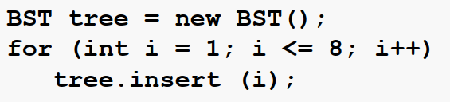
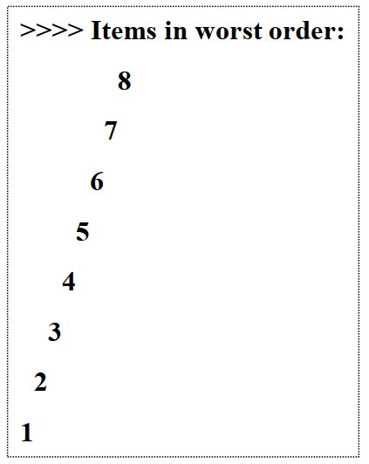
Worst Case
Output

Slide 52
Balanced BSTs
Prevent the degeneration of the BST :
A BST can be set up to maintain balance during updating operations (insertions and removals)
To achieve a worst-case runtime of 𝑂(log 𝑛) for searching, inserting and deleting, h = 𝑂(log 𝑛)
Two types we’ll look at :
AVL trees (named after inventors Adelson-Velsky and Landis)
splay trees
There are many other types of balanced BSTs: 2-4 trees, Red-Black trees, B-trees

Slide 53

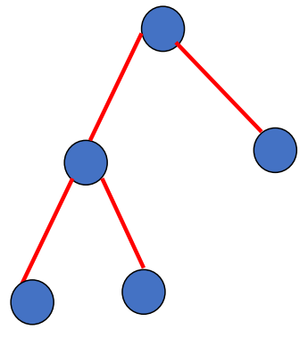
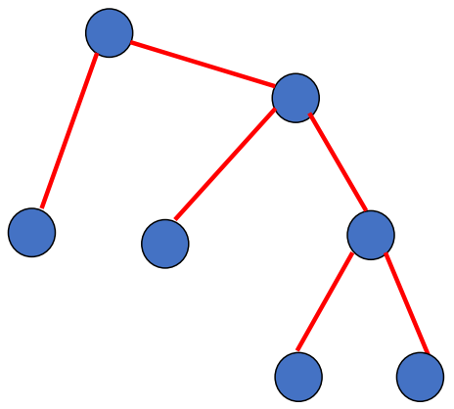
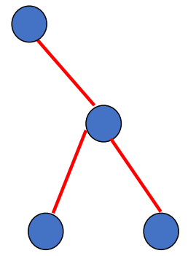
AVL Trees
Invented in 1962 by Russian mathematicians Adelson-Velsky and Landis
An AVL tree is a binary search tree such that (AVL property):
The height of the left and right sub-trees of the root differ by at most 1
The left and right sub-trees are AVL trees
treat nil tree as height -1
Which of these are AVL trees, assuming that they are BSTs?

Slide 54
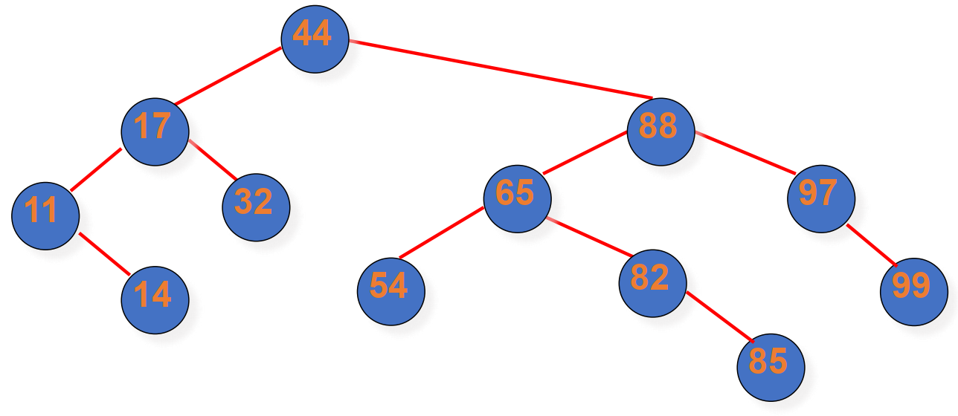
Valid AVL Tree
Note: it is not a requirement that all leaves be on the same or adjacent level

Slide 55
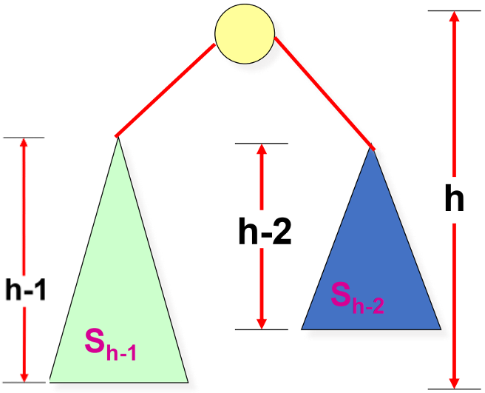
AVL Trees: Balanced
Aim to get a tight upper bound for ℎ
Worst when the height of the left and right sub-trees of every node differs by 1
let 𝑁_{ℎ} = (𝑚𝑖𝑛.) # nodes in height-ℎ AVL tree
𝑁_{ℎ} = 𝑁_{ℎ−1} + 𝑁_{ℎ−2} + 1
> 2𝑁_{ℎ−2}
𝑁_{ℎ} > 2^{ℎ/2}
ℎ < 2 log 𝑁_{ℎ}

Slide 56
AVL Trees: Balanced
Based on 𝑁_{ℎ} = 𝑁_{ℎ−1} + 𝑁_{ℎ−2} + 1, we can have 𝑁_{ℎ−1} as follows by replacing h with h-1
𝑁_{ℎ-1} = 𝑁_{ℎ−2} + 𝑁_{ℎ−3} + 1
We can plug 𝑁_{ℎ-1} into 𝑁_{ℎ}, and obtain the following
𝑁_{ℎ} = 𝑁_{ℎ−1} + 𝑁_{ℎ−2} + 1 = (𝑁_{ℎ−2} + 𝑁_{ℎ−3} + 1)+ 𝑁_{ℎ−2} + 1 = 2𝑁_{ℎ−2} + 𝑁_{ℎ−3} + 2
So, we have 𝑁_{ℎ} > 2𝑁_{ℎ−2.} We can replace h with h-2, obtaining 𝑁_{ℎ-2} > 2𝑁_{ℎ−4}
We can plug the above into 𝑁_{ℎ} > 2𝑁_{ℎ−2} to obtain the following
𝑁_{ℎ} > 2𝑁_{ℎ−2} > 2×2𝑁_{ℎ−4} => 𝑁_{ℎ} > 2²𝑁_{ℎ−2×2} => 𝑁_{ℎ} > 2^{k}𝑁_{ℎ−2k}
When h-2k = 0, i.e., k = h/2, we have
𝑁_{ℎ} > 2^{h/2}𝑁₀ => 𝑁_{ℎ} > 2^{h/2} => log(𝑁_{ℎ}) > h/2 => 2log(𝑁_{ℎ}) > h
With h < 2log(𝑁_{ℎ}), we can easily get h=O(log(𝑁_{ℎ})) using the definition of big O.

Slide 57
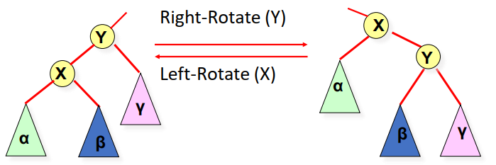
Rotations
Rotations maintain the ordering property of BSTs.
A rotation is an O(1) operation

Slide 58
AVL Insert
(1) insert as in simple BST
(2) work your way up tree, restoring AVL property (and updating heights as you go).
suppose x is the lowest node violating AVL
assume x is right-heavy (left case symmetric)
two cases:
Case 1: x’s right child is right-heavy or balanced → single rotation
Case 2: else → double rotations
then continue up to x’s parent, grandparent, greatgrandparent . . .

Slide 59
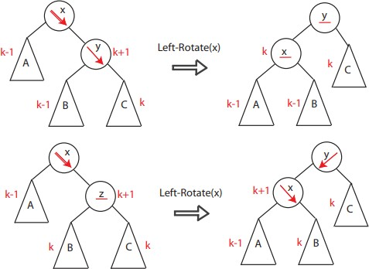
Case 1

Slide 60
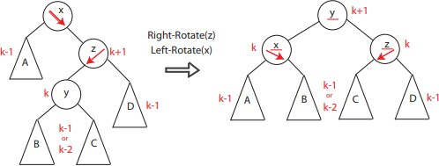
Case 2

Slide 61
Restructuring
The four ways to rotate nodes in an AVL tree, graphically represented
-Single Rotations:
c = z
single rotation
b = y
b = y
a = x
c = z
a = x
T
T
3
0
T
T
T1
T
T
0
2
2
3
T
1

Slide 62
Restructuring (cont’d)
double rotations:
c = z
double rotation
b = x
a = y
a = y
c = z
b = x
T
0
T
1
T
3
T
2
T
0
T
2
T
3
T
1

Slide 63
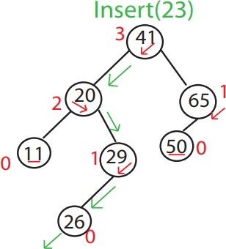
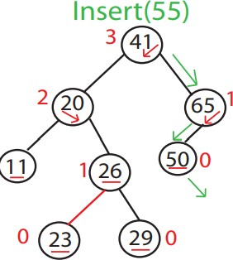
Example

Slide 64
Balancing AVL tree
void balance( AvlNode * & t ) {
if( t == NIL ) return;
if( height( t->left ) - height( t->right ) > 1)
if( height( t->left->left ) >= height( t->left->right ) )
rotateWithLeftChild( t );
else
doubleWithLeftChild( t );
else if( height( t->right ) - height( t->left ) > 1)
if( height( t->right->right ) >= height( t->right->left ) )
rotateWithRightChild( t );
else
doubleWithRightChild( t );
t->height = max( height( t->left ), height( t->right ) ) + 1;
}

Slide 65
Balancing AVL tree
void rotateWithLeftChild( AvlNode * & k2 ) {
AvlNode *k1 = k2->left;
k2->left = k1->right;
k1->right = k2;
k2->height = max( height( k2->left ), height( k2->right ) ) + 1; k1->height = max( height( k1->left ), k2->height ) + 1;
k2 = k1;
}

Slide 66
Comments
In general, process may need several rotations before done with an Insert. 𝑂(log 𝑛) rotations may be required
Deletion is similar — harder but possible.
Running time for inserting each item into AVL tree?

Slide 67
Advantages/Disadvantage of AVL Trees
Advantages
𝑂(log 𝑛) worst-case searches, insertions and deletions
Disadvantages
Complicated Implementation
Must keep balancing info in each node
To find node to balance, must go back up in the tree: easy if pointer to parent, otherwise difficult
Deletion complicated by numerous potential rotations

